Slide 1

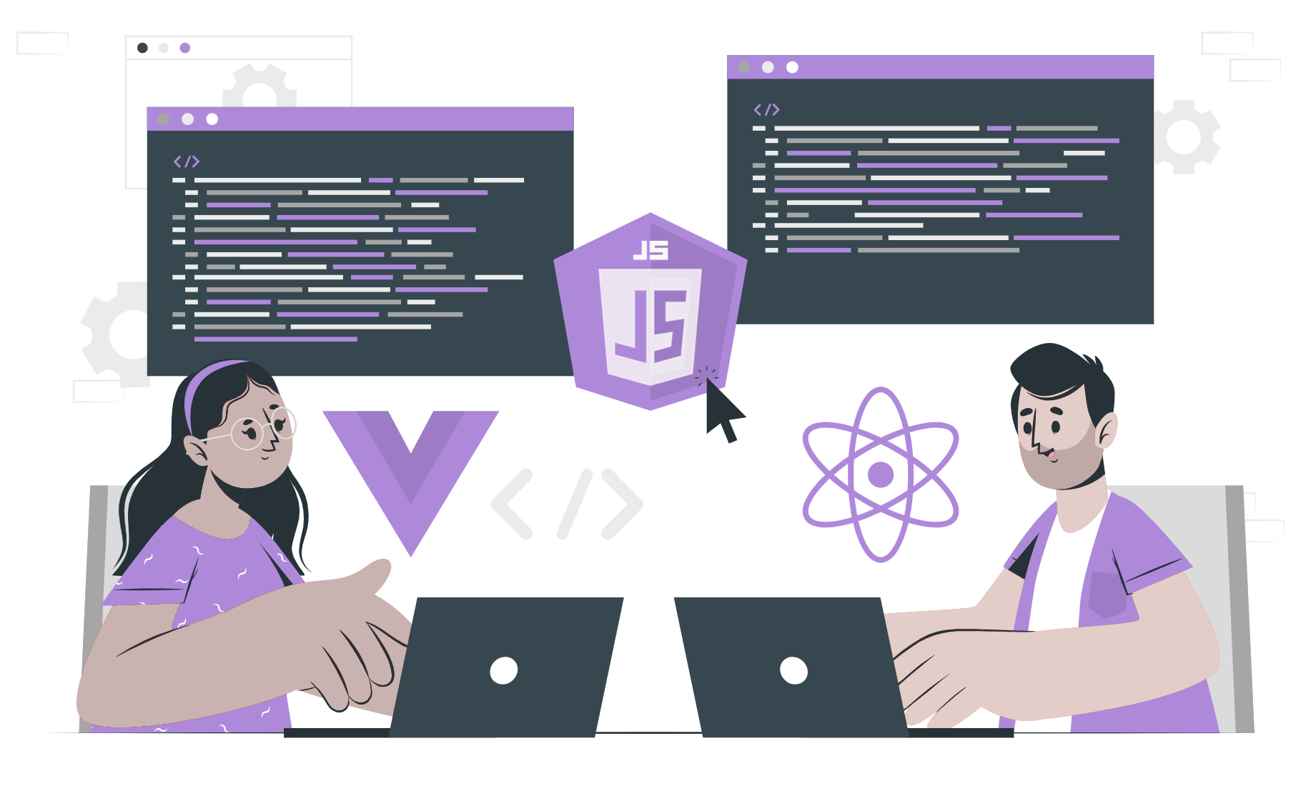
create-react-app

Slide 2
Create react App
We can create a react app by using create-react-app tool.
We can use either npx or npm to create a react application.

Slide 3
Boilerplate
node_modules.
public
Src
package.json
.gitignore
README.md
yarn.lock or package-lock.json

Slide 4
THANK YOU

